Slide 1
Quick Start Kafka
A Hitchhikers Guide to Kafka

Slide 2
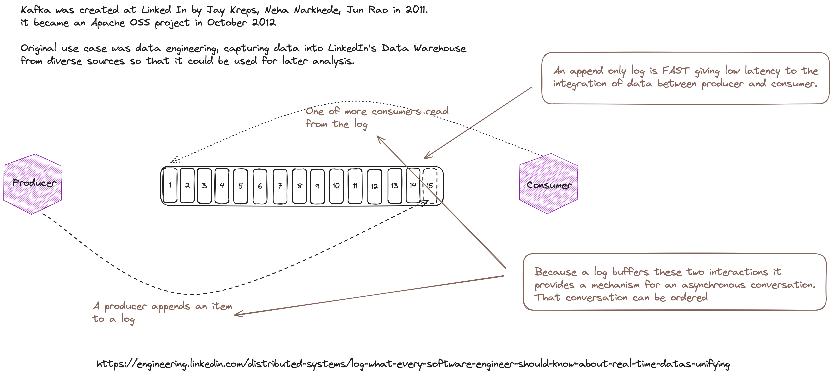

Slide 3
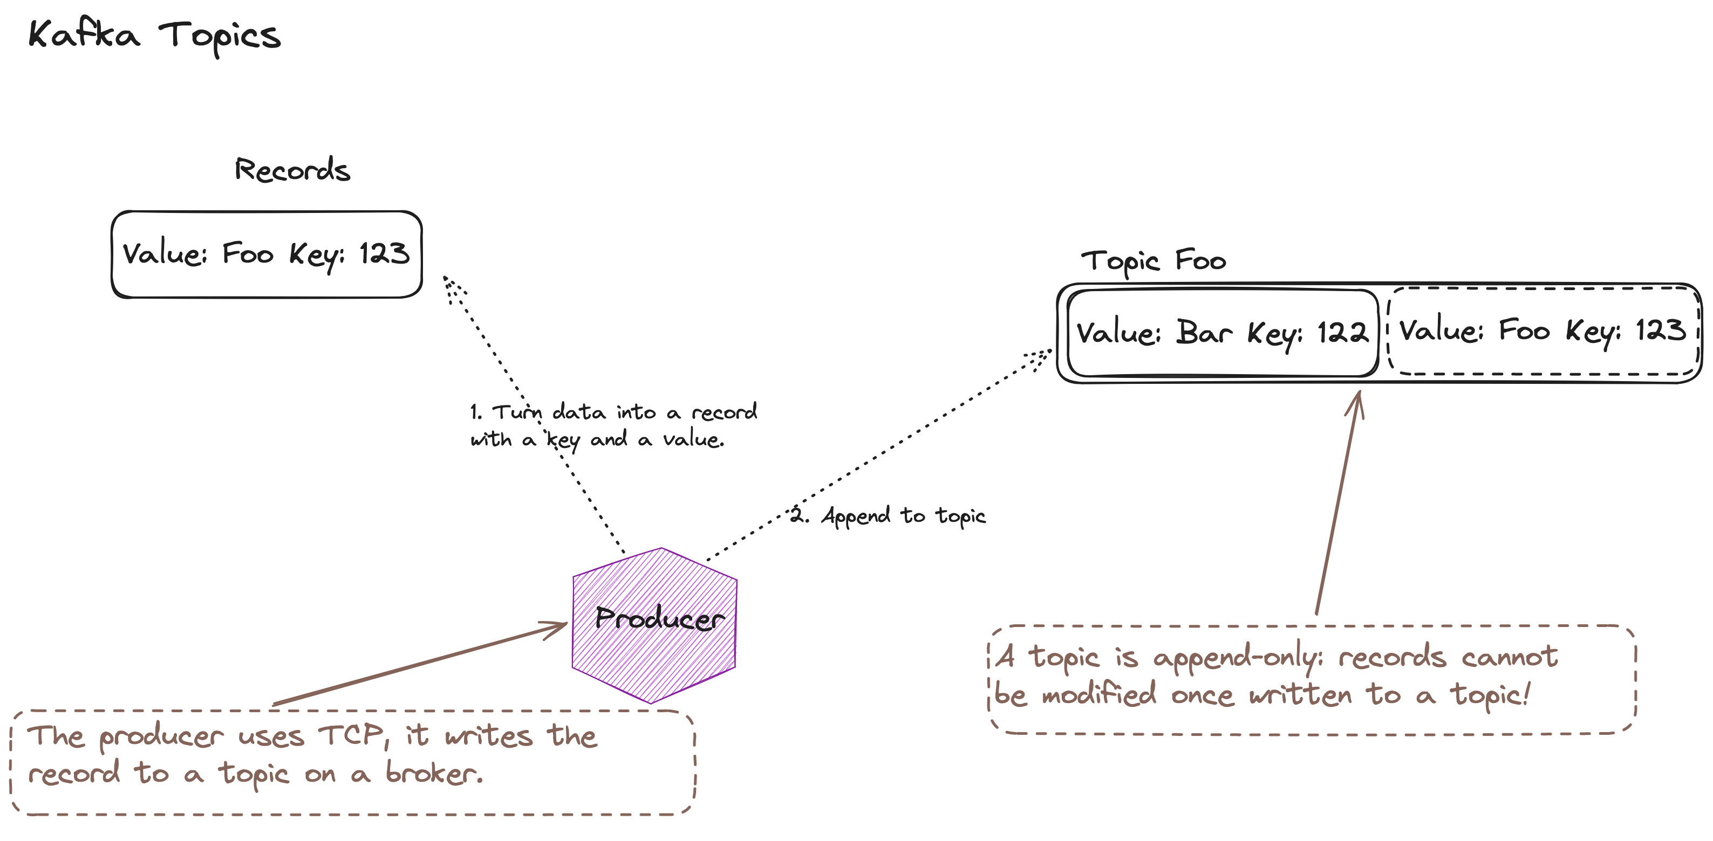

Slide 4
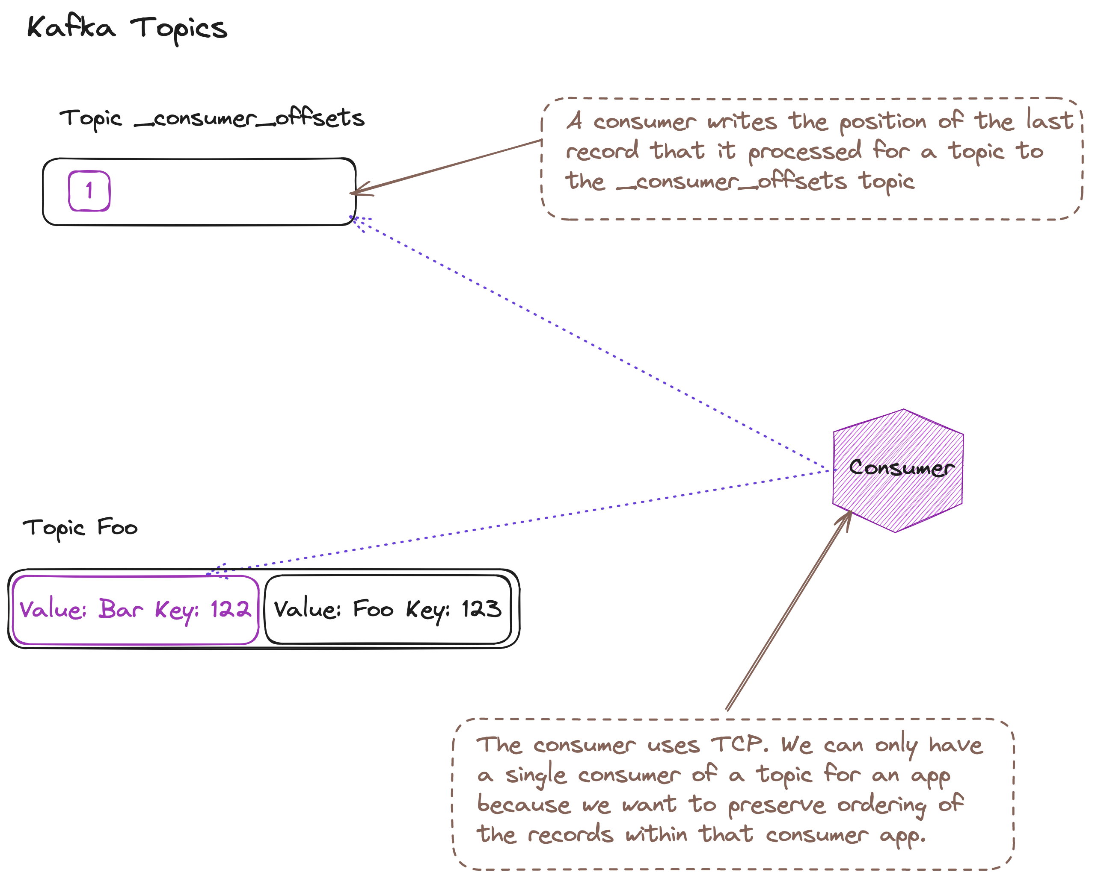

Slide 5
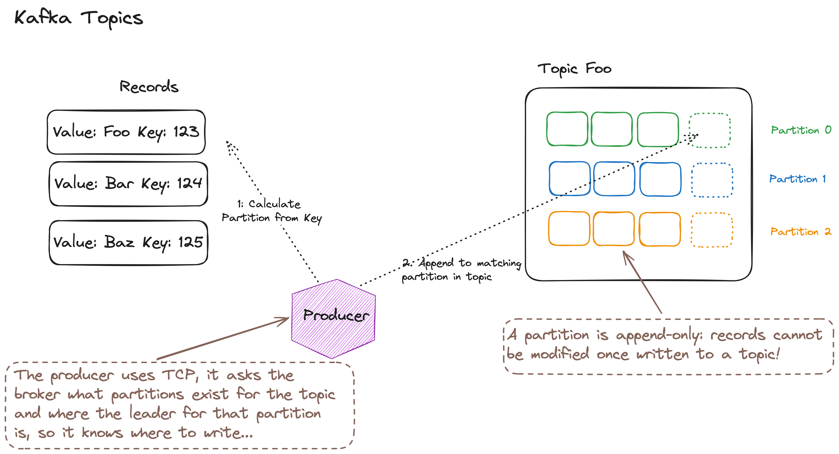

Slide 6
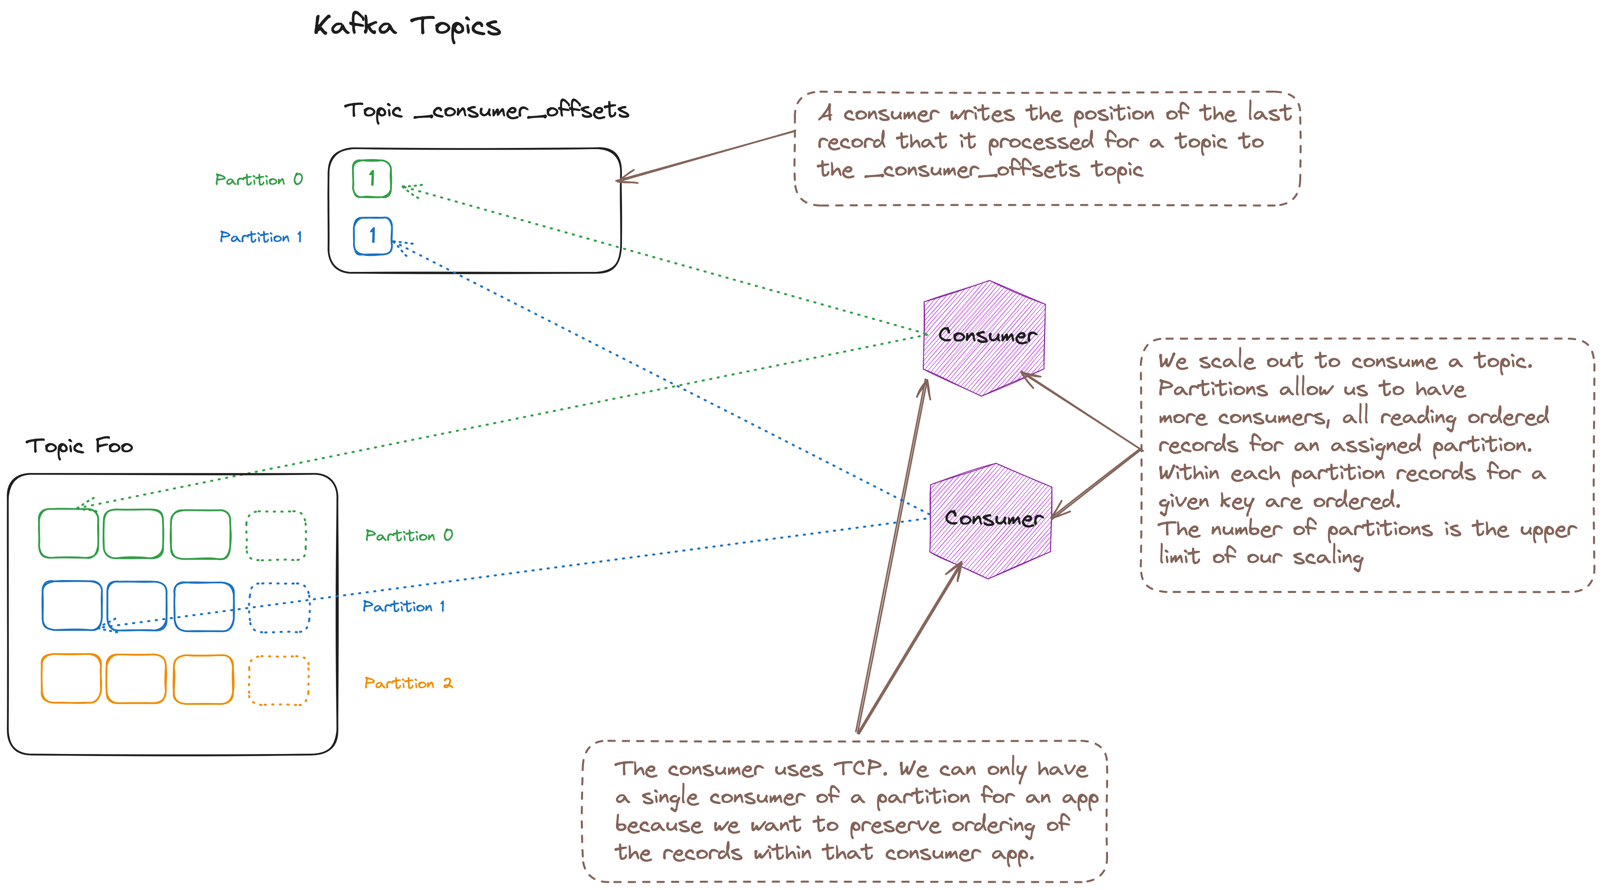

Slide 7
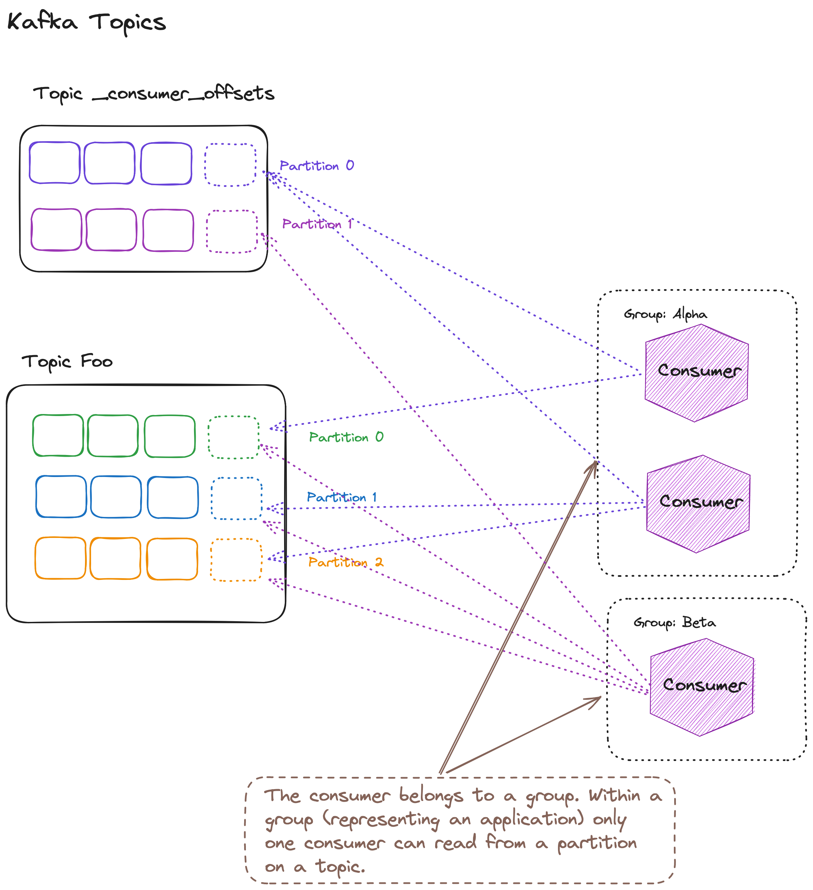

Slide 8
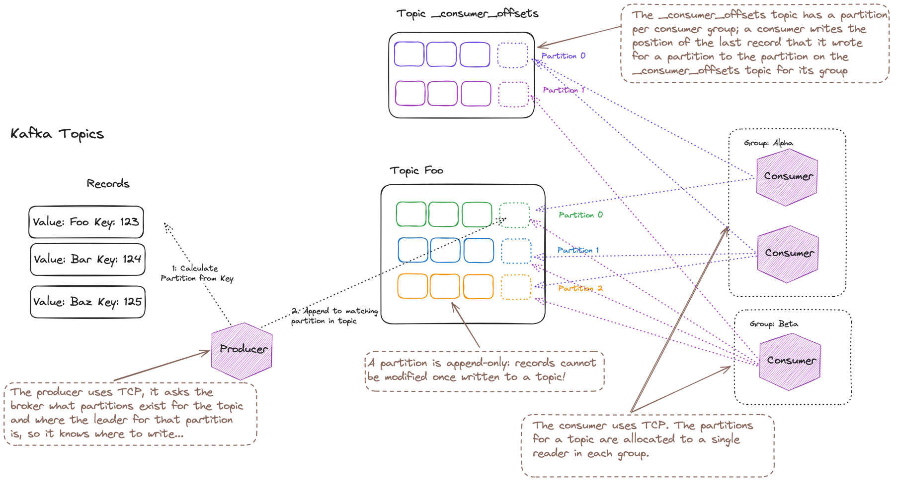
Notes:
An overall picture of how Kafka works

Slide 9
EnableAutoCommit = true
AutCommitIntervalMs = n milliseconds
Your consumer want to commit an offset to Kafka
EnableAutoCommit = true
AutCommitIntervalMs = n milliseconds
Yes
Yes
EnableAutoOffsetStore = false
Call StoreOffset to commit offset when processed
Do you want to commit at an time interval or in batches?
Yes
Are you alright to commit read offsets, that may not have been processed?
No
Do you want to commit at an time interval or in batches?
No
No
Monitor batch count in your code
Call Commit() when you want to commit offsets
Monitor batch count in your code
Call Commit() with specific offsets when you want to commit offsets

Slide 10
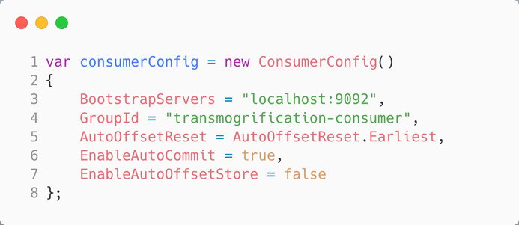
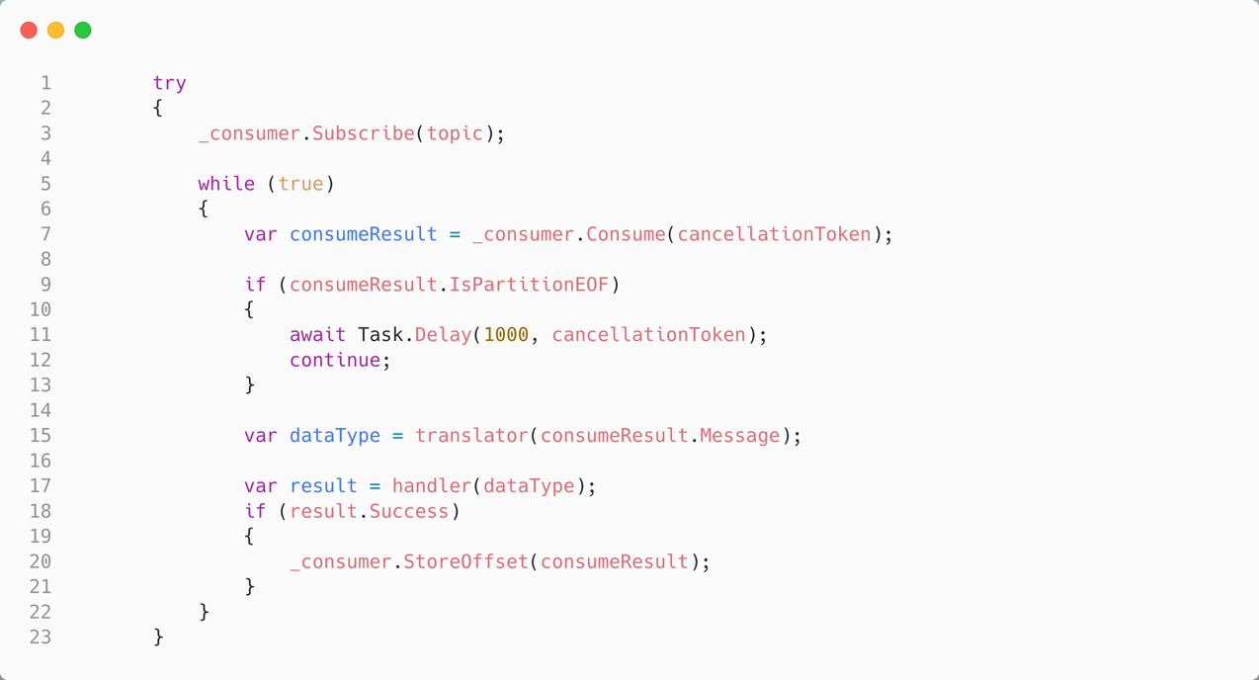
Auto Commit, Manually Store Offsets in C#
EnableAutoOffsetStore = false
Manually store offsets to the consumer’s cache; autocommit will write on a background thread
This means we only store processed records (every 5s)

Slide 11
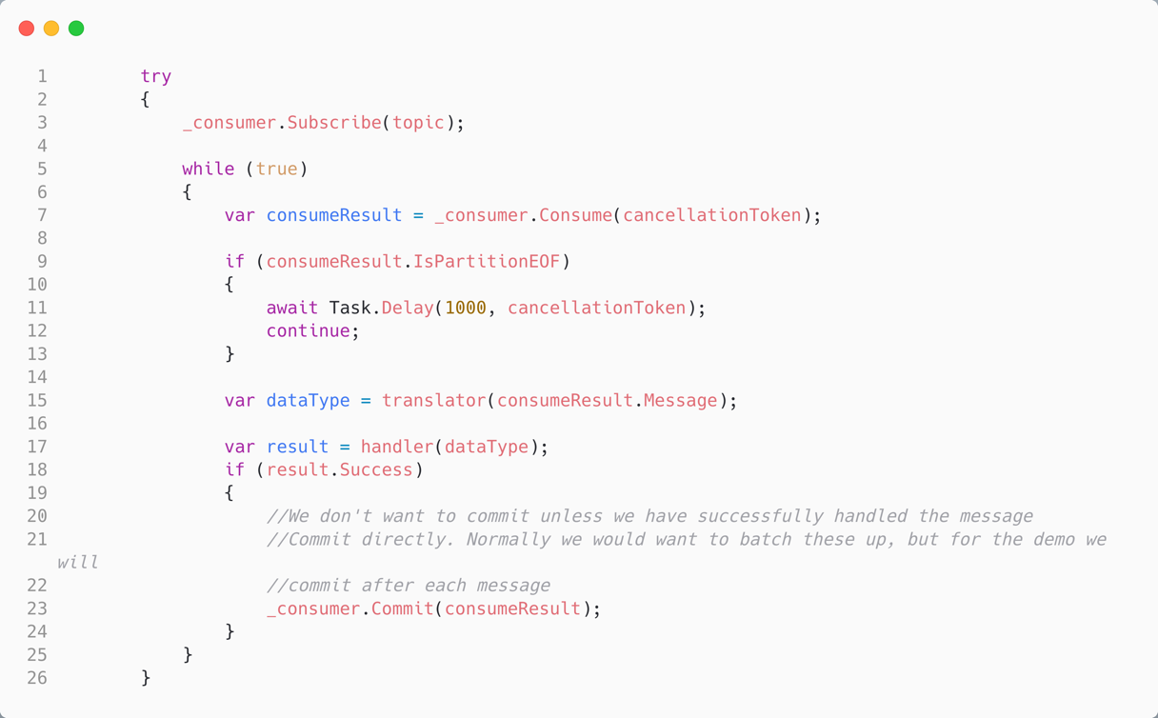

Manually Commit, Manually Store Offsets in C#
EnableAutoOffsetStore = false
EnableAutoCommit = false
We choose to manually store the commits
Manually store commits with:
_consumer.Commit(consumeResult)

Slide 12
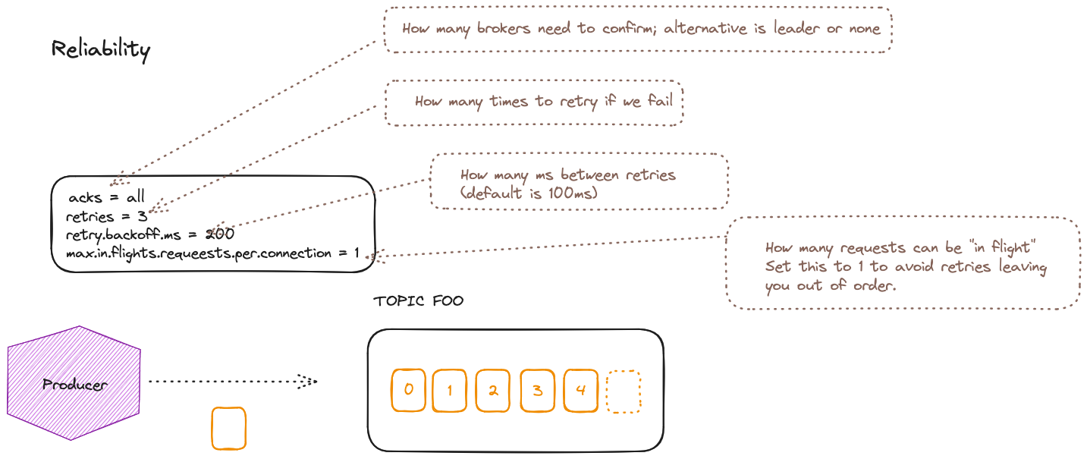

Slide 13
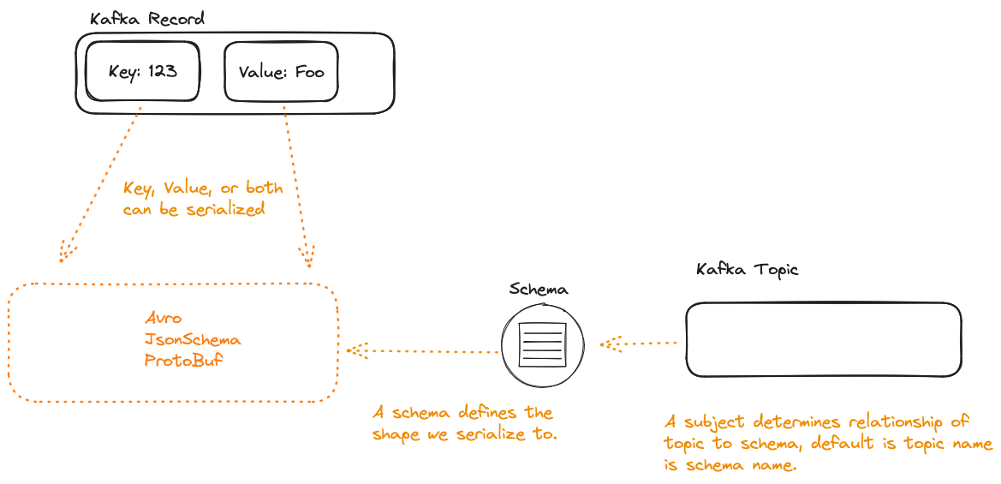

Slide 14
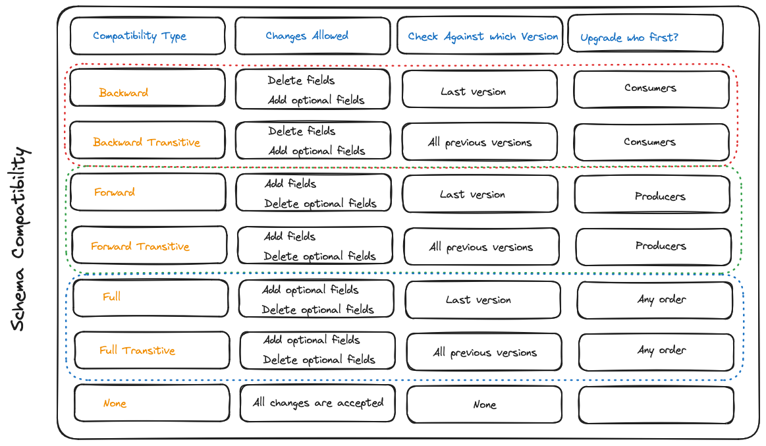
Consumers using the new version can read messages with the last version
Producers using the new version can send messages to consumers with the last version
Producers and consumers may be on the last version and still communicate

Slide 15
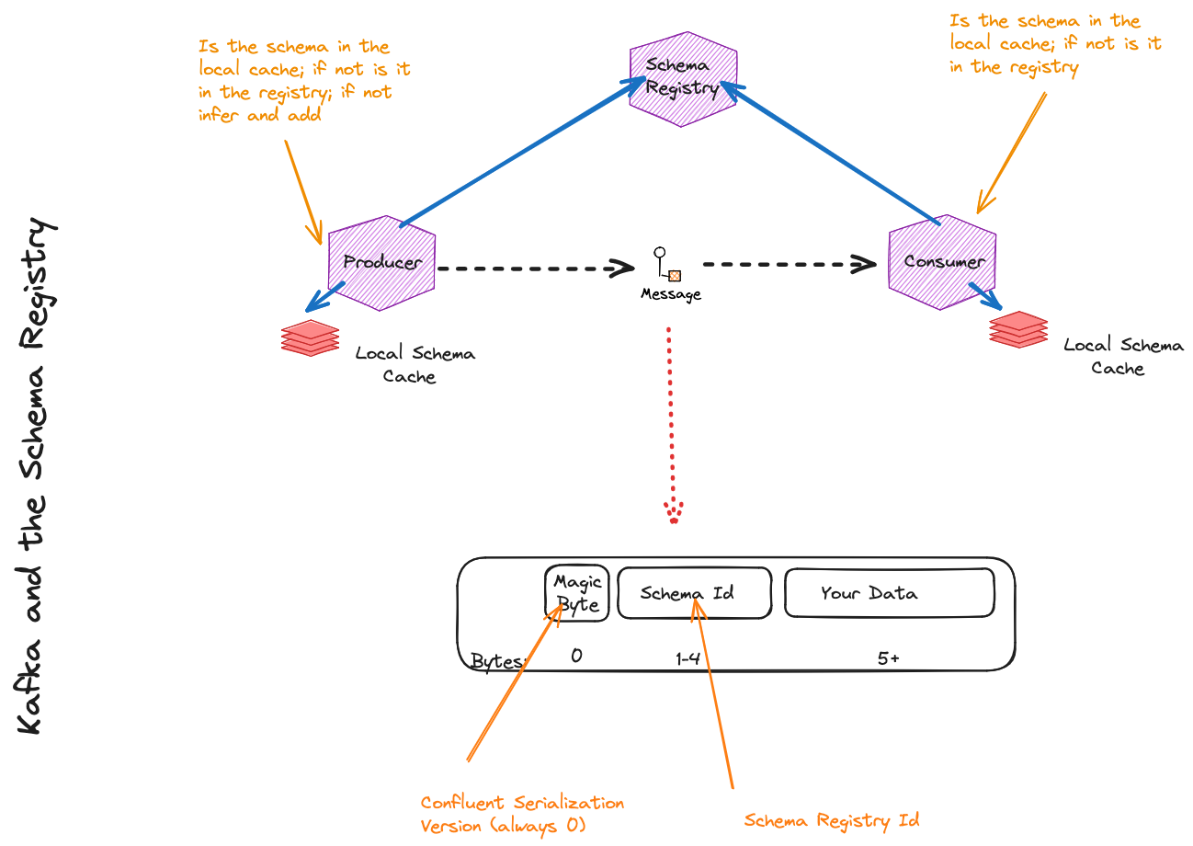
Notes:
Worth noting, consider the value as bytes, even if you have serialized JSON

Slide 16
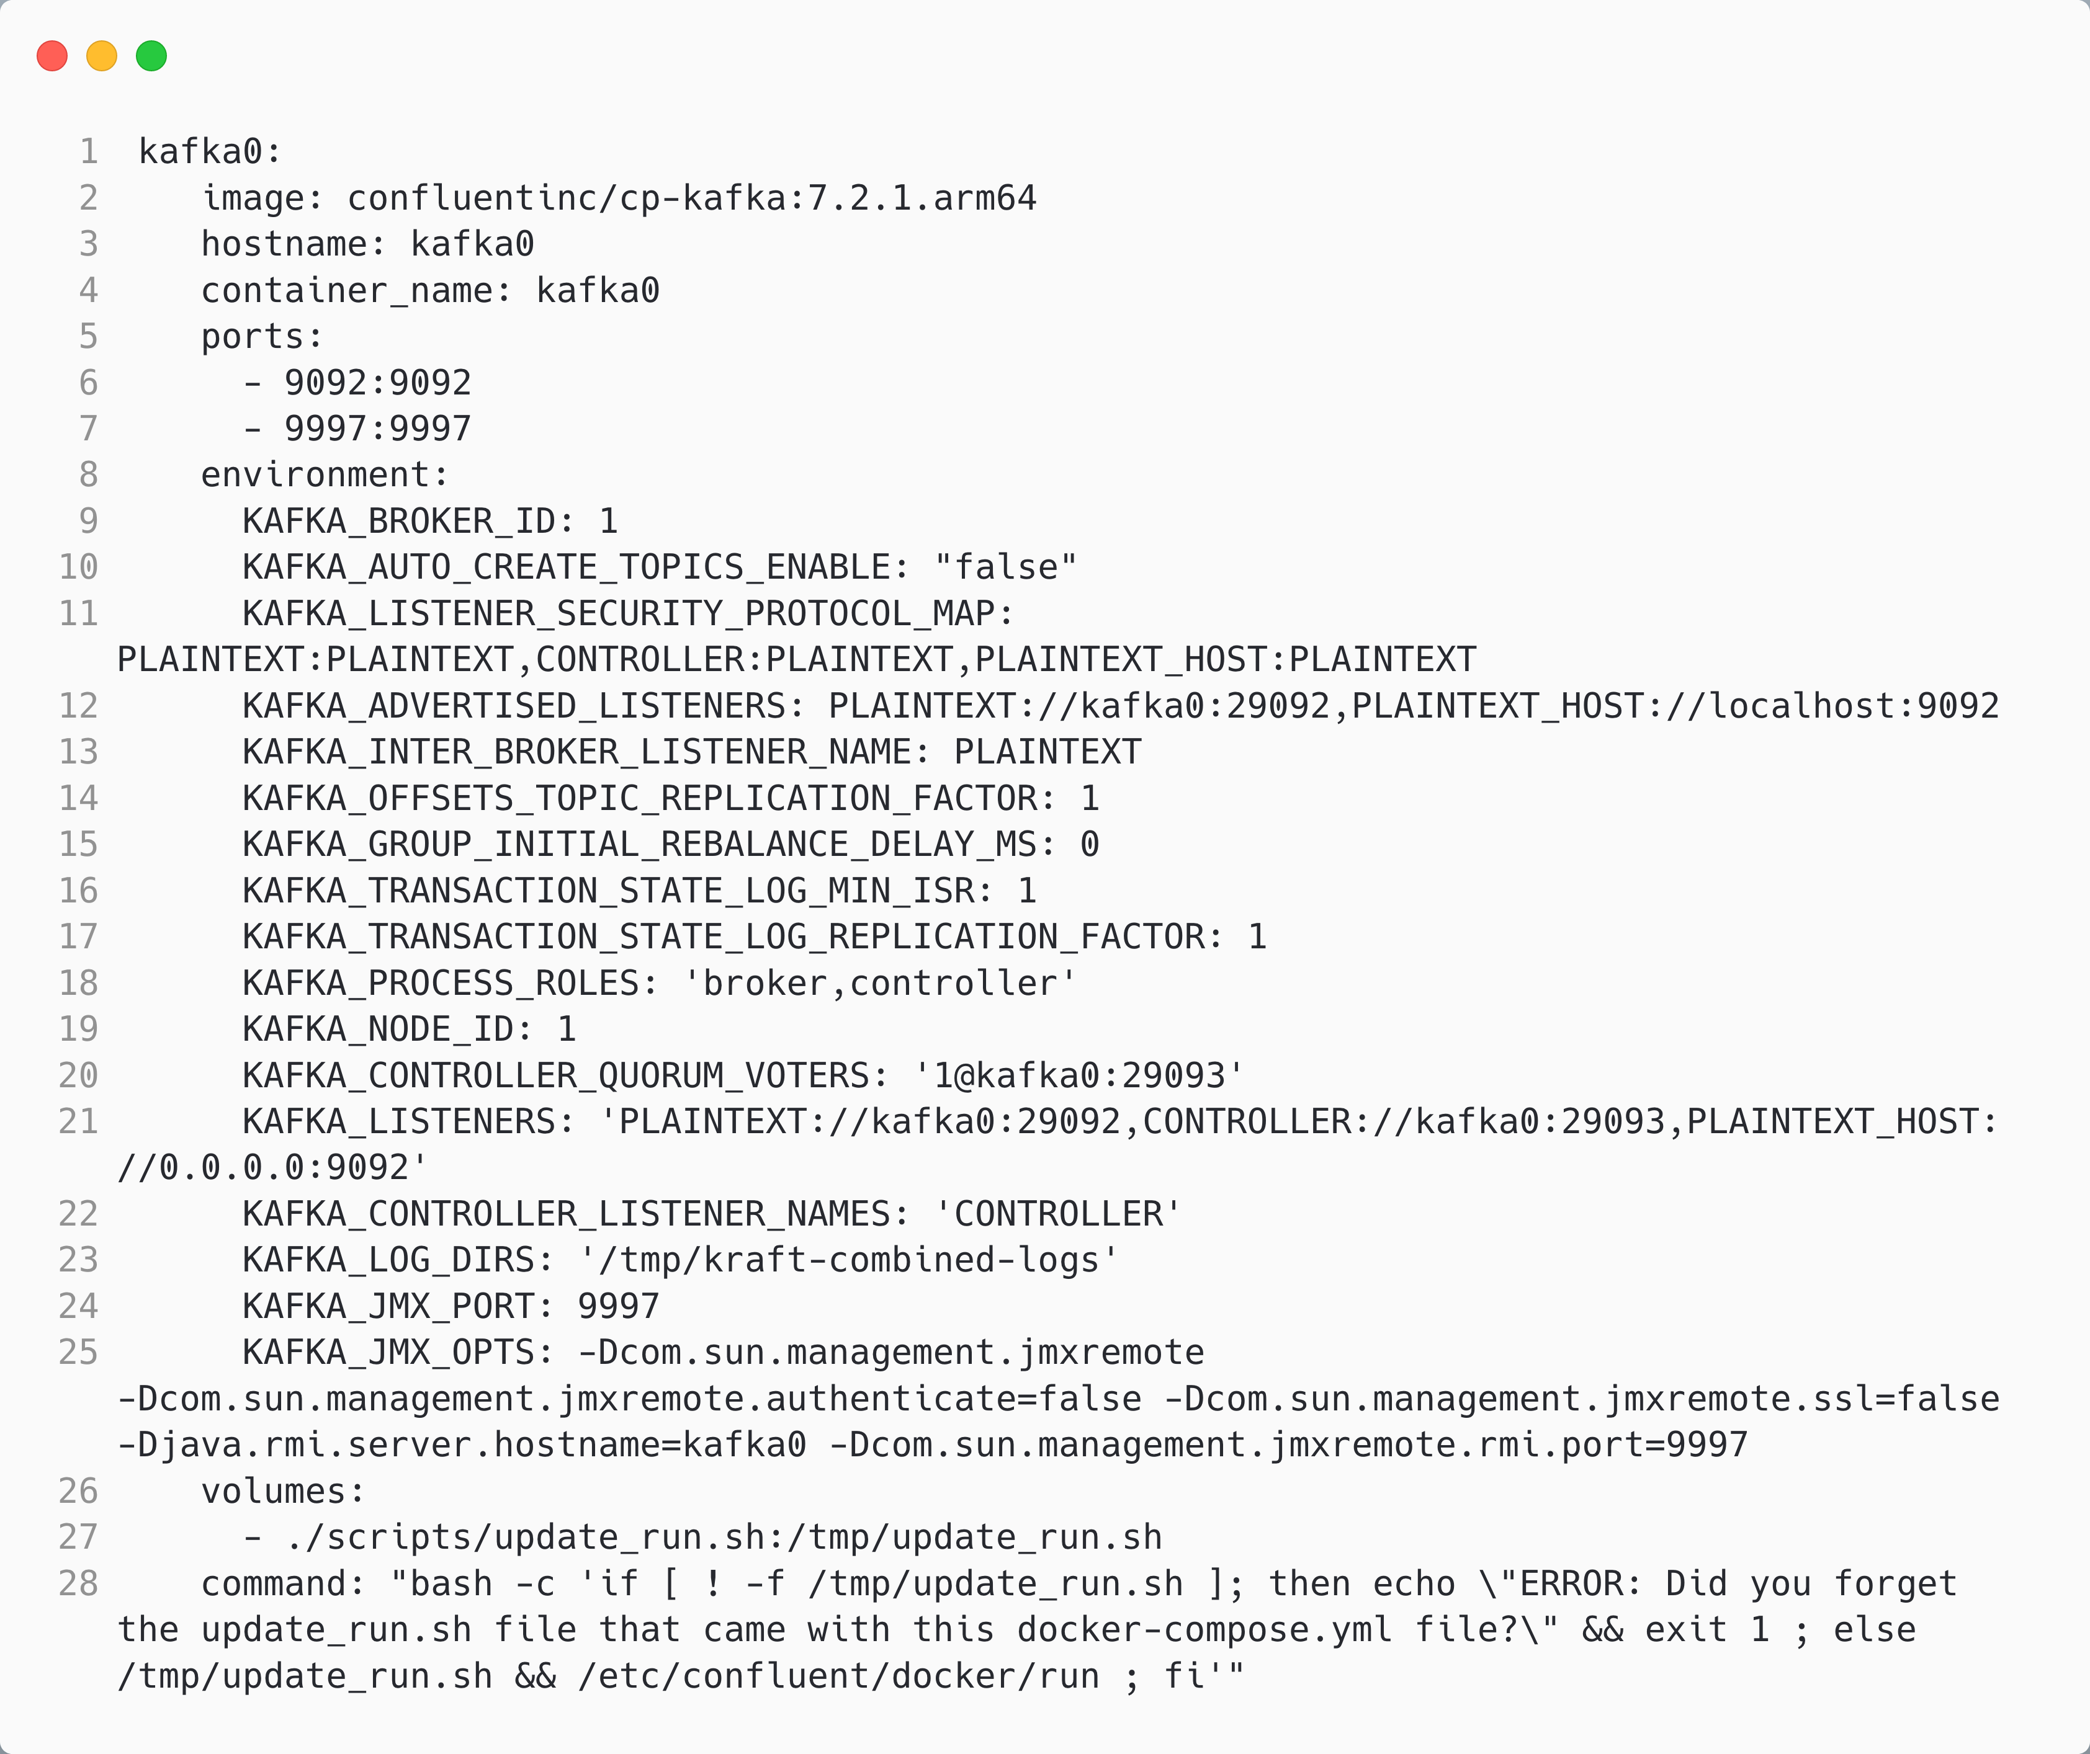
Running Kafka
If a topic does not exist when a producer writes, what should Kafka do?
The advertised listeners are the endpoints that clients should use to communicate with broker
The roles that this node plays
The listeners are the endpoints that the broker listens on
We need to run a script to run without zookeeper

